Slide 1
Town of Sutton
Health Savings Account Enrollment

Slide 2
What We’re Going to Discuss Today:
What is an HSA?
Managing Your Account
Getting Started
ENROLLMENT

Slide 3
What is an HSA?

Slide 4
What is an HSA?
There are two components to the HSA Solution: The High Deductible Health Insurance Plan (HDHP) + the Health Savings Account (HSA).
The HDHP component is the health insurance used to cover expenses for illness or injury after meeting a minimum deductible amount (per plan design).
The HSA component is the tax-advantaged account which can be used to cover medical expenses before the insurance deductible is met. Funds may also be saved for future medical expenses.
Enrollment | HSA

Slide 5
What is an HSA?
Protects you from big
medical bills
High Deductible Insurance (HDHP)
Health Savings
Account Plan
Helps pay your deductible
+
Tax-deductible deposits
Health Savings Account (HSA)
Tax-deferred growth
Tax-free for medical care
Enrollment | HSA

Slide 6
Key Features
Use HSA dollars for qualified medical expenses tax-free
HSAs are individually owned accounts
Pre-tax contributions can be made to the account
HSAs earn interest (tax-free)
Funds are portable & roll over year to year
No “use it or lose it” rule
HSAs can build up significantly
No balance limit
Enrollment | HSA

Slide 7
HSA Eligibility
Must be enrolled in an HSA-qualified High-Deductible Health Plan (HDHP)
Cannot be covered by any other insurance that reimburses for health expenses (including a medical FSA)
Cannot be enrolled in any part of Medicare or Medicaid
Cannot be claimed as a dependent on another person’s tax return
Enrollment | HSA

Slide 8
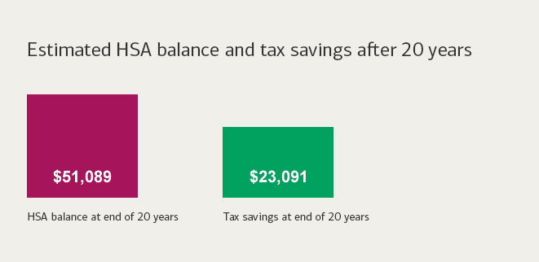
How HSA Contributions Impact Taxes
HSA contributions are exempt from
the following payroll taxes:
Social Security
Medicare
Federal income tax
State income tax/unemployment tax (with the exception of California)
Pre-tax contributions facilitated by an employer are documented on an employee W-2 in Box 12 with a Code “W.”
Enrollment | HSA

Slide 9
How to Contribute
Annual IRS Maximum
 | Single | Family
Contribution | $ 3,600 | $ 7,200
Catch-Up Contribution | $ 1,000 | $ 1,000
Who Makes Contributions?
Account holder
Employer
Third Party
How Are They Made?
Payroll deductions
Online transfers
Checks
Transfers or rollovers
Contributions from all sources count toward the annual maximum.
Enrollment | HSA

Slide 10
Town Of Sutton Contribution
$1,000 for individual Coverage/ $2,000 for family coverage
An employee with individual coverage can contribute an up to an additional $2,600*
An employee with family coverage can contribute an up to an additional $5,200*
*Employees age 55 or older can contribute an additional $1,000

Slide 11
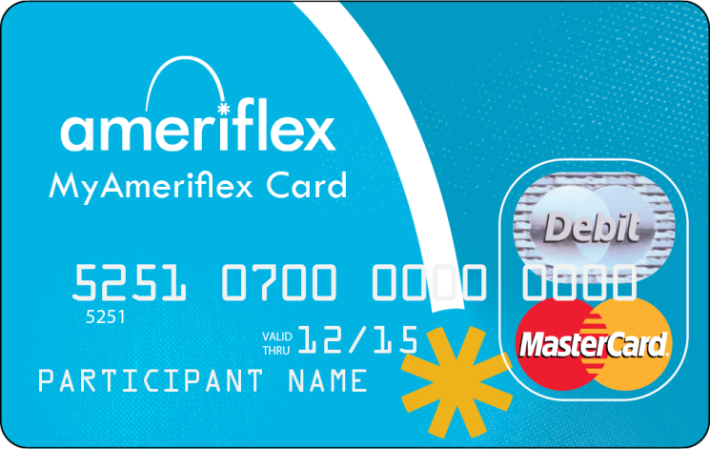
Distribution Options
Debit Card
Reimburse with External Transfer
HSA Checks (Upon request)
Enrollment | HSA

Slide 12
What Can You Do With Your HSA Dollars?
According to IRS guidelines, funds within your HSA can be used for qualified medical expenses (See https://www.irs.gov/pub/irs-pdf/p502.pdf Publication 502).
HSA dollars may be used by the account holder, the account holder’s spouse, and any tax dependents.
Distributions can be taken at any time; HSA reimbursements can be taken for expenses from prior years as long as the account was already established.
Save your receipts!
Account holders are responsible for maintaining receipts to prove HSA funds were used for qualified
medical expenses if audited
by the IRS.
Enrollment | HSA

Slide 13
Qualified Medical Expenses
Doctor and hospital visits
Medical equipment
Dental care, braces, dentures
Vision care, glasses, contacts
Medications, including many
over-the-counter
Medical-related transport
Premiums for long-term care insurance
Limited to amounts listed in 213(d) 10 of IRS Code
Premiums for COBRA
Premiums for individuals over the age of 65
Retirement health benefits
Medicare premiums
Enrollment | HSA

Slide 14
Non-Medical HSA Distributions
Under Age 65:
65+ Years Old:
It is possible to withdraw funds, but not advisable. Must pay income taxes plus a penalty on the non-medical dollar amount.
No penalties for non-qualified distributions. Pay only income taxes on those dollar amounts withdrawn for non-medical items.
Enrollment | HSA

Slide 15
| WHO ARE THEY?
FDIC insured, full-service financial institution located in Massachusetts with a focus on HSA administration
Provides private label banking as well as affinity programs, employing a partnership approach to create HSA solutions with clients’ needs in mind
A mutual bank with over $1 billion in assets answering to our customers needs and not shareholders
Offers big bank financial services at an affordable price with the personal attention provided by smaller financial institutions
A strategic partner with leading technology vendors (such as Alegeus)
Size combined with strategic partners allows for a scalable solution at an affordable price
Enrollment | HSA

Slide 16
| SERVICES
| SERVICES
Feature | Details
Monthly Account Fee | $0
Monthly Investment Account Fee | $2.50 *
Debit Card(s) | Free
Bill Payment | Free
Checks (25 count) | $8.00
On-Line & Mobile | Free
Paper Statements | $1.25
Paperless Online Statements | $0
Investment Option | Yes
Minimum Deposit Required | No
* To be eligible for the investment feature your HSA must have a $1,000 available balance, and the fee will be waived, if your HSA has a monthly average balance of $3,500.
Enrollment | HSA

Slide 17
Ameriflex LPFSA Features
A Limited Purpose Flexible Spending Account (LPFSA) is similar to a regular, general-purpose health FSA. Unlike a regular FSA, funds in a LPFSA can only be used to pay for qualifying dental, vision, and orthodontia expenses.
An LPFSA is a eligible compliment that allows participants to strategically elect up to an additional $2750.00 for Vision & Dental expenses, while still maintaining their full HSA balance.
The account is set up so it can be used alongside a Health Savings Account (HSA) .
With an LPFSA, participants can make contributions to both the LPFSA and the HSA. In turn, this allows them to maximize their savings and tax benefits.
LPFSA

Slide 18
Account Management

Slide 19
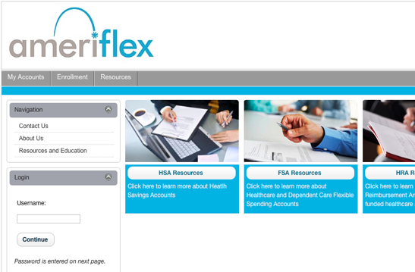
Log in to MyAmeriflex
Access enrollment resources
Check balance
Request Reimbursement
Order a new card (free of charge!)
Pay a provider
ACCOUNT MANAGEMENT

Slide 20
MyAmeriflex Card
A convenient way to pay for eligible expenses without the hassle of filing manual claims.
Features auto-substantiation and daily claims processing. By using the MyAmeriflex Card, you will no longer have to pay out of pocket and then wait to be reimbursed for your expenses!
ACCOUNT MANAGEMENT

Slide 21
INCLUDED! Identity Theft Protection
A complimentary benefit for all
MyAmeriflex Cardholders.
ID Theft Alerts
Receive instant alerts if any personal information is discovered on malicious websites
Expert Restoration Assistance
In the event of fraud, certified specialists available to guide you through every step of restoration process
Emergency Wallet Replacement Assistance
Receive 24/7 help if a wallet, handbag and/or its contents are lost or stolen
ACCOUNT MANAGEMENT

Slide 22
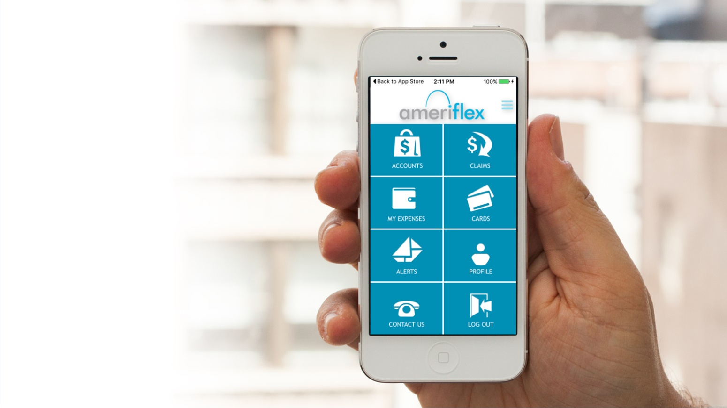
MyAmeriflex Mobile App
Convenience and award-winning customer service – right at your fingertips!
ACCOUNT MANAGEMENT

Slide 23
We are here to help!
We hope that you found this information useful as you prepare to get started with your new plan!
We are here to help you take advantage of all the savings and convenience that your plan has to offer. Visit our website to access all relevant forms and materials, or contact our dedicated Participant Services team with any questions that you may have.
Online: myameriflex.com – Live Chat Available!
Toll-Free: 888.868.FLEX (3539)
ENROLLMENT

